Slide 1



Unfolding en espectrometria de neutrones: problemática y lecciones aprendidas a partir del ejercicio del WG6 de EURADOS
REUNION DEL CEIDEN – GUN
CNA (Sevilla)
8 y 9 de junio de 2022
C. Domingo, J.M. Gómez-Ros, R. Bedogni
Universitat Autònoma de Barcelona. 08913 Bellaterra (Barcelona). ES
CIEMAT. 28040 Madrid. ES
LNF-INFN. 00044 Frascati (Roma). IT

Slide 2
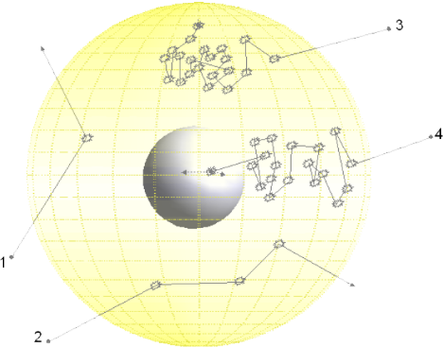
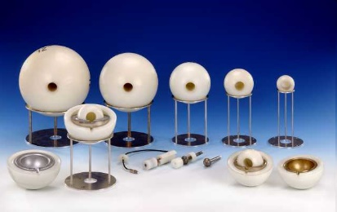

The Bonner spheres spectrometer (BSS). Unfolding
Set of moderating spheres with different radius.
A thermal neutron detector is located in the centre.
For every sphere (i), the fluence response, R_{i}(E),
to monoenergetic neutrons of energy E is:
M_{i} : instrument reading
Φ : neutron fluence
For a neutron spectrum with energy distribution of fluence Φ_{Ε} :
unfolding
For a neutron spectrum with N energy groups, φ_{j}:
D.J. Thomas, A.V. Alevra. Bonner sphere spectrometers: a critical review. Nucl. Instrum. Meth. A. 476 (2002) 12–20
M. Matzke. Neutron spectrometry in mixed fields: unfolding procedures. Radiat. Prot. Dosim. 107 (2003) 37-72
D.J. Thomas. Neutron spectrometry. Radiation Measurements 45 (2010) 1178-1185

Slide 3
The Bonner spheres spectrometer (BSS). Unfolding
number of spheres
(number of equations)
number of energy groups
(number of variables)
<
underdetermined problem
(infinite mathematically possible solutions)
Spectrum is modelled as a function of
(physically meaningful) parameters
initial guess values needed
Spectrum is modelled as
N_{G} energy groups (N_{G} > N)
guess spectrum needed
D.J. Thomas, A.V. Alevra. Bonner sphere spectrometers: a critical review. Nucl. Instrum. Meth. A. 476 (2002) 12–20
M. Matzke. Neutron spectrometry in mixed fields: unfolding procedures. Radiat. Prot. Dosim. 107 (2003) 37-72
D.J. Thomas. Neutron spectrometry. Radiation Measurements 45 (2010) 1178-1185

Slide 4
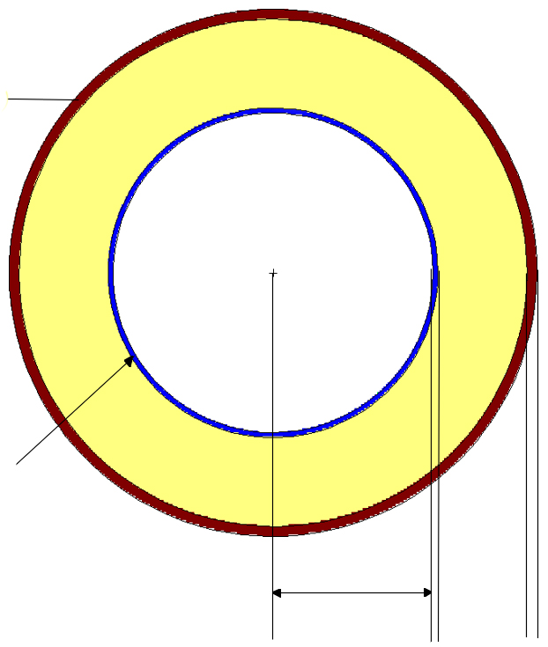
Proposed problem: BSS Response matrix
Detector: Ø32 mm ³He sphere + 0.5 mm steel case
Spheres set: bare, 2”, 2”+1 mm Cd, 3”, 3.5”, 4”, 4.5”, 5”, 6”, 7”, 8”, 10”, 12”
Response: number of ³He(n,p)³H
Cd
polyethylene
³He
steel
16 mm
1 mm
0.5 mm

Slide 5
LINAC
Workplace field
point 2
Am-Be source suspended in a stainless steel tube
Measurement point: behind a water filled container
point 1
GE Saturne 43, 25 MV
Irradiation room
Skyskhine
Am-Be source in the centre of an iron sphere
(α, n) neutrons in the middle of a cylindrical room, H=10 m, R=10 m
Measurement point: 4 m distance along one diagonal
Measurement point: 100 m distance, 1.5 m above the ground

Slide 6
Reference solution: unfolded spectra

Slide 7
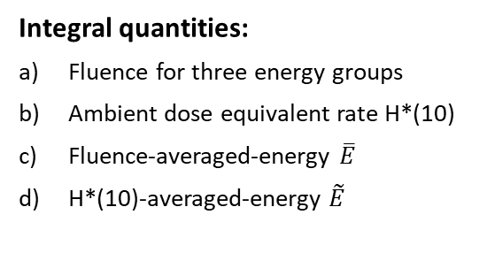
Participants were asked to provide
Unit spectra :
In specific energy bins
Integral quantities:
Fluence for three energy groups
Ambient dose equivalent rate H*(10)
Fluence-averaged-energy $\overline{E}$
H*(10)-averaged-energy $\tilde{E}$
With uncertainties
In standard spreadsheet
Template filling (format and normalization), protected
Some managed to manipulate and change the template
Questionaire
Information about how unfolding was performed, guess spectra, how uncertainties were evaluated...
+

Slide 8
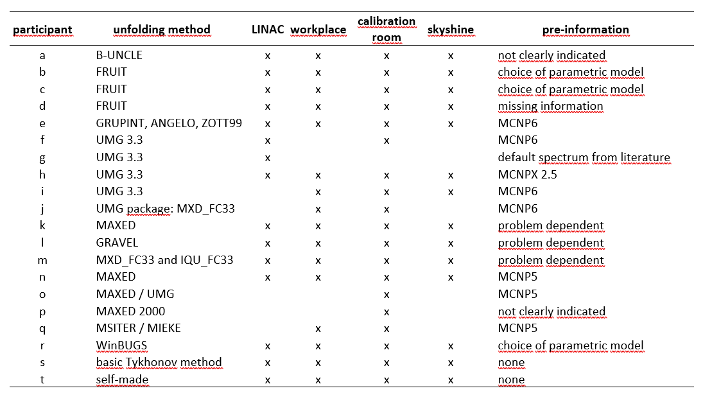
Participation and submitted solutions
20 participants from 15 countries

Slide 9
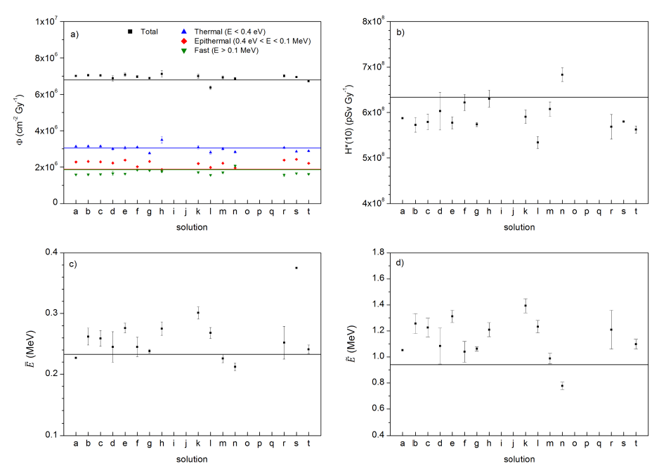
Submitted solutions, LINAC p1: 15
point 1

Slide 10
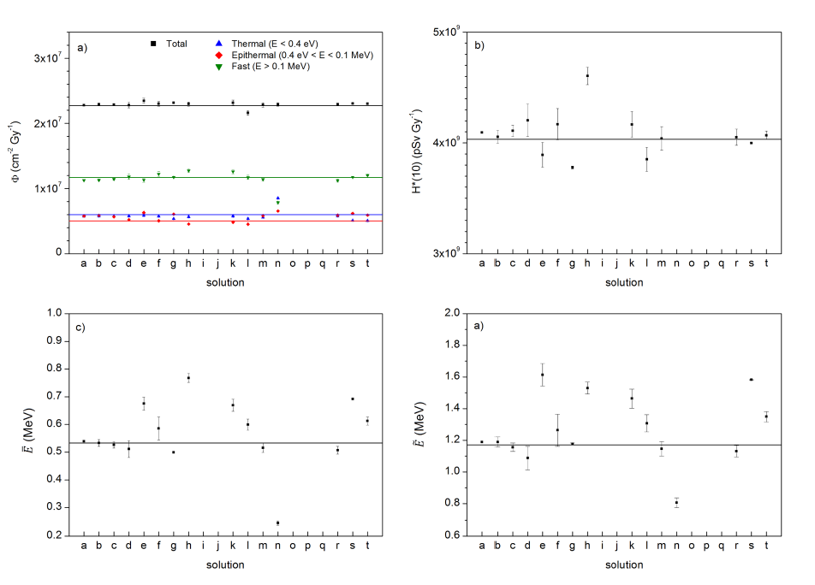
Submitted solutions, LINAC p2: 15
point 2

Slide 11
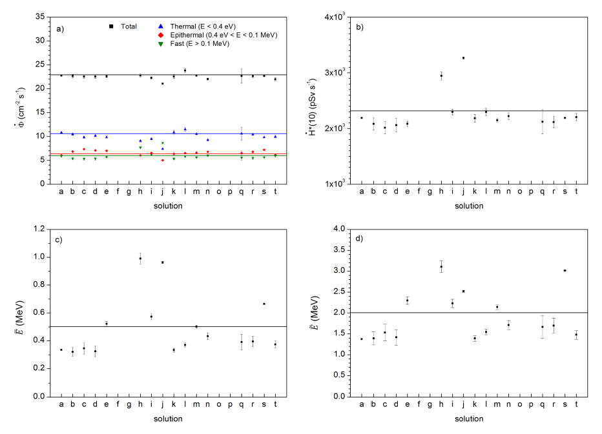
Submitted solutions, simulated workplace field: 16

Slide 12
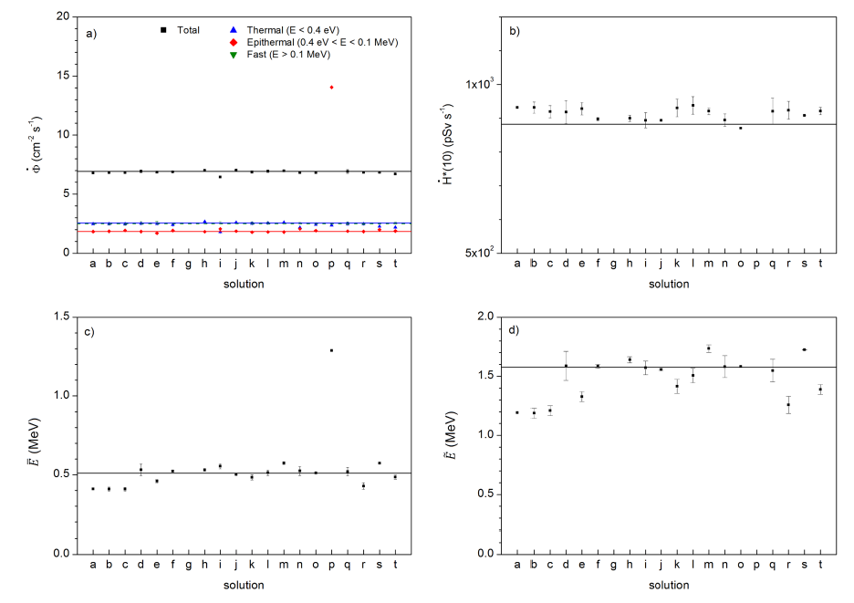
Submitted solutions, calibration facility: 19

Slide 13
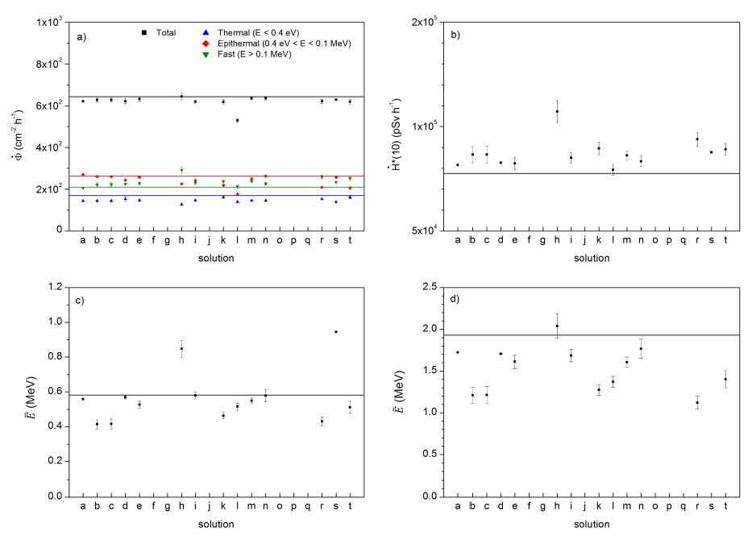
Submitted solutions, skyshine: 14

Slide 14
Lessons
When starting with a BSS problem
Look at the counts profile
These curves should be smooth if the measurements are performed under stable conditions, using the right monitors, and are not affected by supplementary uncertainties of unexplained origin.
Alevra, A.V., Thomas, D.J., 2003. Radiat. Prot. Dosimetry 107 (1-3), 37-72.
“Outliers” could bias the unfolding process, possibly requiring further investigations

Slide 15
Lessons
Preparing the pre-information
Participants spectra were “more discrepant” is “less detailed” problems:
Scenario i) LINAC (40% of solutions)
Scenario iv) Skyshine (70% of solutions were poor).
30% of the submitted solutions were incorrect even for scenarios ii) and iii), where the problem was much better specified in terms of source, sizes and materials
Because the neutron unfolding problem is underdetermined, it has infinite mathematical solutions
An amount of pre-information is always required:
For parametric unfolding: identify the right model and the initial estimation for the parameters
For unfolding methods that alter a “guess spectrum”: Supply a plausible guess spectrum
The pre-information should be accurately chosen and “assembled”, and all available a-priori data should be implemented
Unfolding a radionuclide source with shadow cones? Impose zero thermal neutrons
Is the minimum/maximum energy known? Impose lower/upper energy cut

Slide 16
Lessons
After unfolding
Plotting the unfolded spectrum. Unrealistic results, could be identified by eye:
Negative fluence values?
Double thermal peak?
Thermal peak shifted to unrealistic energies
Folding the response matrix with the “resulting spectrum” and comparing with the Reference BSS counts:
Considerably larger deviations with respect to uncertainties should warn the user
The compatibility of folded vs. reference BSS counts is a necessary condition BUT it does not guarantee itself the correctness of the spectrum (unfolding is an underdetermined problem)
Using a pure “flat-in-lethargy” guess, the resulting spectrum may give “an idea” of the energy regions with larger/smaller fluence, but it is often far from being correct.
The value of fluence integrated over a large energy domain may tend to be correct even when the spectrum shape is not correct.
Not the case of H*(10), heavily depending on the energy distribution!
Comparing with literature data for similar scenarios (IAEA TRS 318 and TRS 403)

Slide 17
Summary
BSS unfolding is un underdetermined problem. Additional information is required to get a physically meaningful solution: initial guess values or guess spectrum.
A first check of the obtained unfolded spectrum can be made by folding it with the response matrix to compare the result with the BSS counts.
Additional checks (e.g. comparison of the unfolded spectrum with previous result or published reference spectra) is highly advisable.
Amazing results use to be incorrect / inaccurate results
Additional details can be found at:
Radiat. Prot. Dosim. 180, 70-74 (2018), https://doi.org/10.1093/rpd/ncy002
Radiat. Meas. 153, 106755 (2022), https://doi.org/10.1016/j.radmeas.2022.106755

Slide 18
Conclusions
Although computer codes for unfolding BSS data have been in use for a long time, their application remains a complex task that needs some technical skills and experience in the specific field.
This is true regardless of whether or not the unfolding problem itself is inherently complex. Indeed, the results of this exercise suggest that difficulties exist in general during attempts to correctly perform BSS unfolding tasks. This difficulty, expressed in terms of the proportion of incorrect solutions, was observed to have a base value of about 30% even in the simple scenarios considered here (ii and iii), for which almost complete prior information was available. The difficulty then tends to increase as the pre-information decreases.
Preparing reliable pre-information for BSS unfolding is crucial.
Because the neutron unfolding problem is underdetermined, even validated unfolding codes may lead to inaccurate solutions if the code is fed non-realistic information.

Slide 19
Conclusions
Unfolding codes, even the most sophisticated and documented ones, cannot be used without the required expertise of the user if accurate results are to be obtained. To that end, such users should:
have sufficient physical knowledge of the radiation environment to enable him/ her to estimate the appropriate likely characteristics of that field
have sufficient mathematical capabilities to translate that physical knowledge into a priori information that may be suited for the specific unfolding code being used;
have sufficient experience to enable him/her to correctly judge the results of the unfolding process for likely plausibility and accuracy.

Slide 20


