Slide 1
Nuclear R&D in Japan after the Fukushima NPP Accident
Kunihisa Soda
Japan Atomic Energy Agency
Tokyo, Japan
Presented at the National Technology Forum for Nuclear Fission Energy,
CEIDEN, Madrid, Spain, October 15, 2012

Slide 2
Contents
Nuclear Power Generation in Japan
Before and after the Fukushima NPP accident
Safety Issues after the Fukushima NPP Accident
Tohoku Pacific Ocean Earthquake
Issues of Importance for Nuclear Safety
Recommendation of the Investigation Committees
New Regulatory Organization of Japan
Research and Development for Nuclear Safety
Towards High Level of Safety
Decommission of Fukushima Dai-ichi NPP
For future

Slide 3
Nuclear Power Generation in Japan
Ref. Agency for Natural Resources and Energy, “Nuclear Energy 2010”, March 31, 2010
東北電力(株)東通原子力発電所
北海道電力(株)泊発電所
電源開発(株)大間原子力発電所
東京電力(株)柏崎刈羽原子力発電所
1
2
1
2
3
1
2
3
4
5
6
7
東京電力(株)東通原子力発電所
北陸電力(株)志賀原子力発電所
1
2
東北電力(株)女川原子力発電所
1
2
1
2
3
日本原子力発電(株)敦賀発電所
東北電力(株)浪江･小高原子力発電所
1
2
3
4
関西電力(株)美浜発電所
Operation 54 48.8 GW
Construction 2 2.8
Preparation 12 16.6
Total 68 68.2
For commercial nuclear power generation as of March 31, 2010*
1
2
3
東京電力(株)福島第一原子力発電所
関西電力(株)大飯発電所
1
2
3
4
5
6
7
8
1
2
3
4
東京電力(株)福島第二原子力発電所
関西電力(株)高浜発電所
1
2
3
4
1
2
3
4
日本原子力発電(株)東海第二発電所
中国電力(株)島根原子力発電所
1
2
3
中部電力(株)浜岡原子力発電所
中国電力(株)上関原子力発電所
3
4
5
6
1
2
九州電力(株)川内原子力発電所
四国電力(株)伊方発電所
九州電力(株)玄海原子力発電所
1
2
3
1
2
3
1
2
3
4
出力規模
運転中
 | 基 数 | 合計出力(万kW)
運 転 中 | 54 | 4884.7
建 設 中 | 2 | 275.6
着工準備中 | 12 | 1,655.2
合 計 | 68 | 6,815.5
建設中
50万kW未満
100万kW未満
100万kW以上
着工準備中
運転終了：日本原子力発電（株）東海発電所 1998.3.31／中部電力（株）浜岡原子力発電所1、2号機 2009.1.30

Slide 4
Nuclear Power Generation in Japan Before and After the Fukushima NPP Accident
Before the Accident
Operation 54 BWR(26), ABWR(4), PWR(24)
Under construction 2 ABWR(1), Full MOX ABWR(1)
Preparation for construction 12 BWR(9), PWR(3) at 8 sites
Sources of power generation (%) in 2009:
Nuclear (29), Natural Gas (29), Coal (25), Hydro (8), Oil (7)
After the Accident
Termination of operation 4 Fukushima Daiichi 1-4 (April 2012)
Restart of operation 2 Ohi-3 and 4 (PWR) (July 2012)
Construction continues 2 Ohma-1 (Full MOX ABWR) , Shimane-3 (ABWR) (Sept 2012)

Slide 5
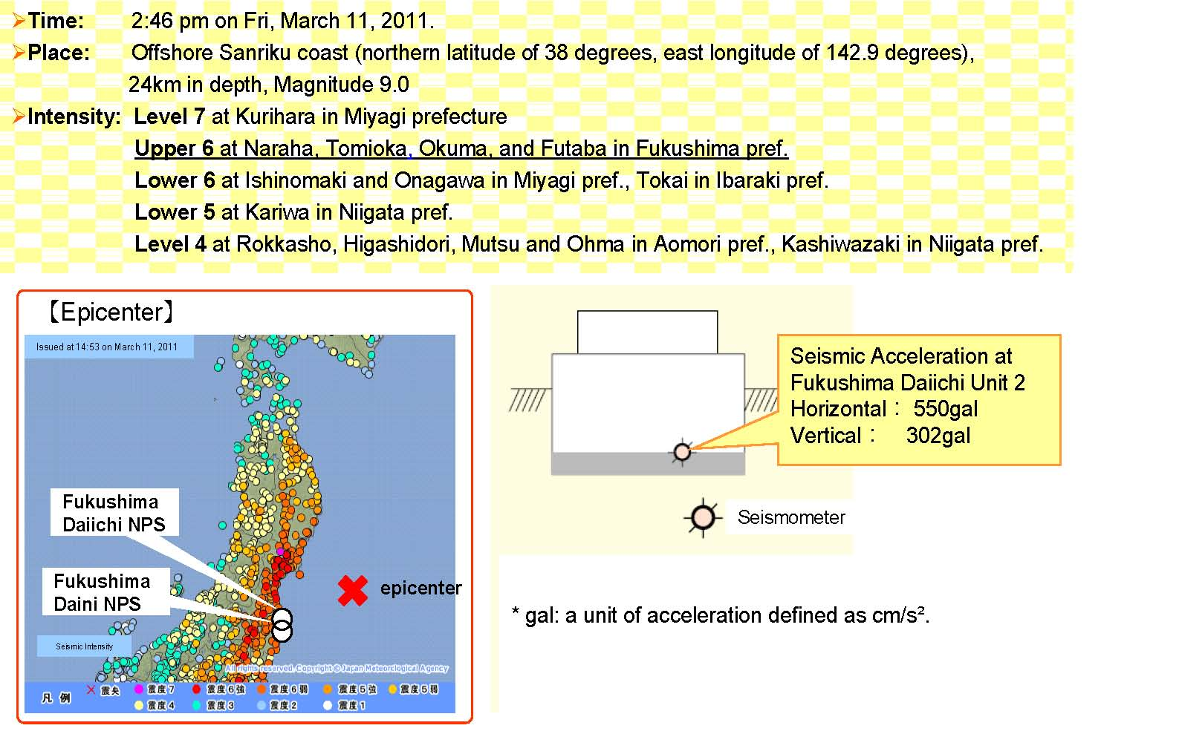
Safety Issues after the FK* NPP Accident Tohoku Pacific Ocean Earthquake
(* denotes Fukushima)
External hazard beyond the design basis
Epicenter
Onagawa NPS
Tokai Daini NPS

Slide 6
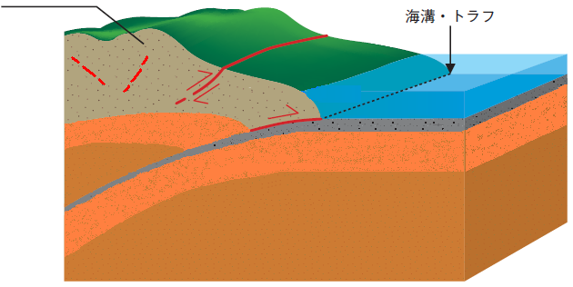
Tohoku Pacific Ocean Earthquake Typical Earthquakes and Active Faults
Inland Crust
Active Fault
Sea Trench
& Trough
Oceanic Crust
3
Oceanic Plate
1
Continental Plate
Plate Movement
Plate Subduction
2
Earthquakes :
Inter Plate E.Q. ,Inland, Intra Plate E.Q., Inside-crust E.Q.
1
2
3

Slide 7
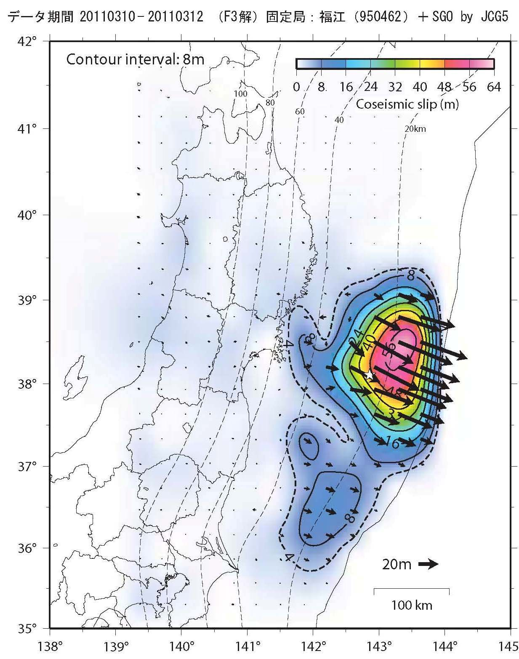
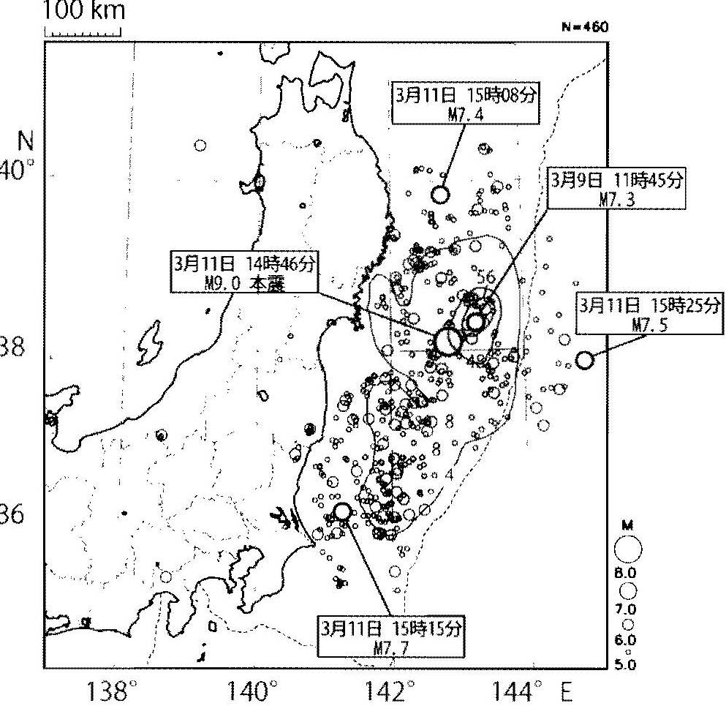
Tohoku Pacific Ocean Earthquake Earthquakes and Coseismic Slip
Ref: (1) N. Hirata, Gakushikaiho, No.893, p84, March 2012, (2) GSI of Japan, http://www.gsi.go.jp/common/000060854.pdf
3.11/15:08
M7.4
3
0 8 16 24 32 40 48 56 64
Coseismic Slip (m)
3.9/11:45
M7.3
1
2
3.11/14:46
M9.0
3.11/15:25
M7.5
5
3.11/15:15
M7.5
4
100km

Slide 8
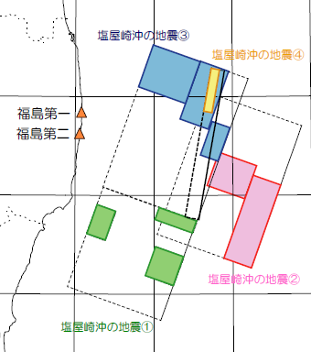
Seismic Safety Analysis at Fukushima NPP For the back-check analysis of seismic safety in 2009
Inland Inside Crust Fault
Inter-plate Earth Quake
from Group of Shioyazaki-Oki Earth Quakes in 1938
a
Fukushima Basin West-side Fault Belt
2
3.11/14:46
M9.0
Futaba Fault
b
57km
3
M7.3
48km
4
M7.4
Fukushima 1
Fukushima 2
2
M7.5
20km
ⓒ Idosawa Fault
1
M7.0

Slide 9
Maximum Response Acceleration Comparison with the licensing basis
Note: The licensing basis was exceeded. |  | Data |  |  | Licensing Basis⁽*⁾
 |  | Horizontal |  | Vertical | Horizontal |  | Vertical
 |  | E-W | N-S |  | E-W | N-S
Fukushima | Unit 1 | 460 | 447 | 258 | 487 | 489 | 412
Daiichi | Unit 2 | 348 | 550 | 302 | 441 | 438 | 420
 | Unit 3 | 322 | 507 | 231 | 449 | 441 | 429
 | Unit 4 | 281 | 319 | 200 | 447 | 445 | 422
 | Unit 5 | 311 | 548 | 256 | 452 | 452 | 427
 | Unit 6 | 298 | 444 | 244 | 445 | 448 | 415
Fukushima | Unit 1 | 254 | 230 | 305 | 434 | 434 | 512
Daini | Unit 2 | 243 | 196 | 232 | 428 | 429 | 504
 | Unit 3 | 277 | 216 | 208 | 428 | 430 | 504
 | Unit 4 | 210 | 205 | 288 | 415 | 415 | 504
Note: ⁽*⁾ Results of the back-check analysis of seismic safety based on the revised seismic safety design guideline.

Slide 10
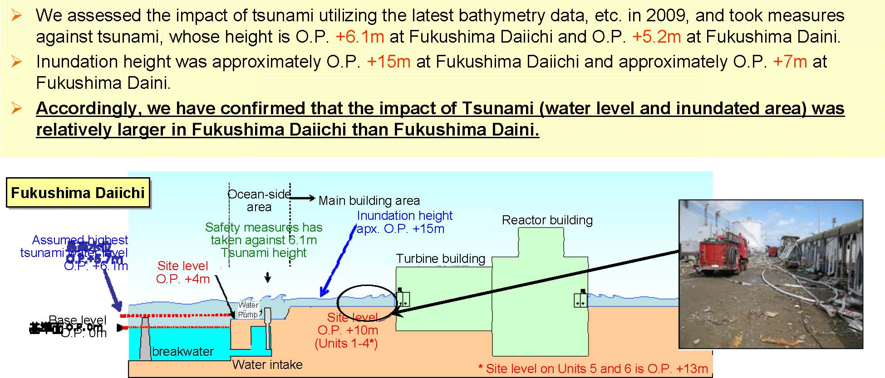
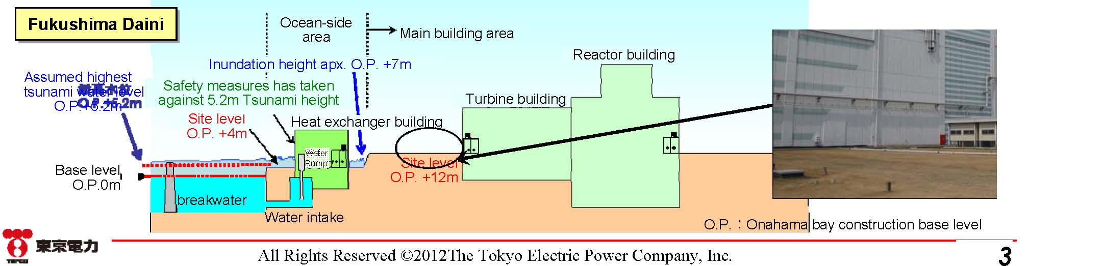
Tsunami At Fukushima Daiichi and Daini NPP
Postulated highest
Tsunami water level
O.P. +6.1m
Base level
O.P. 0m
Postulated highest
Tsunami water level
O.P. +5.2m
Base level
O.P. 0m

Slide 11
Tsunami At Onagawa NPP and Tokai Daini NPP
OK
Onagawa NPS
Ground Level at 13.8 m
Postulated highest
Tsunami water level
O.P. +9.1m
Tokai Daini NPS
Addition of partition wall
Postulated highest
Tsunami water level
T.P. +4.9m
Note: Safety conscious and defense in depth approach saved NPP at Onagawa and Tokai Daini from the tsunami .

Slide 12
Damage by Tsunami Comparison of damages to NPS
NPS | Fukushima Daiichi | Fukushima Daini | Onagawa | Tokai Daini
Ground Level | 10m (Unit 1 to 4) 13m (Unit 5 to 6) | 12m | 13.8m | 8 m
Inundation H (Postulated) | 5.4 to 5.7m | 5.1 to 5.2m | 9.1m | 4.9m
Inundation H (Observed) | 14 to 15m | 6.5 to 7m | 13m | 5.4m
External Power Emergency Generators Cooling | 0/6 0/8 U1 to U4 1/5 U5, U6 Injection N.A (U1 to U4) Lost seawater PMP (U5, U6) | 1/4 3/12 Lost seawater PMP（U1,U2,U4) | 1/5 6/8 Continued | 0/3 2/3 Continued
Note: Safety conscious and defense in depth approach saved NPP at Onagawa and Tokai Daini from the tsunami .

Slide 13
Safety Issues after the FK*NPP Accident Issues of importance for nuclear safety (1/2)
External Hazard beyond the design basis
Earthquake, tsunami, typhoon, flood, volcano etc.
Man made hazard
Accident Management to prevent and mitigate severe accident
Mitigate accident consequences and prevent severe accident to protect the public and the environment.
Secure availability of Engineering systems, Emergency power and cooling water supply, Communication tools, operators, Instrumentations to provide information to operators etc.
Be aware of independency as well as inter-dependency at multiple unit site.

Slide 14
Safety Issues after the FK*NPP Accident Issues of importance for nuclear safety (2/2)
Crisis Management
Protection of the public and workers from radiation hazard
Coordination among the central and local governments, operating organization, regulatory bodies, expert teams etc.
International cooperation and information exchange
Exchange of information and experience

Slide 15
Safety Issues After the FK* NPP Accident Investigation by the Government Committees
The two committees of the Diet and of the Cabinet for investigation of the Fukushima Nuclear Power Plants were established in 2011 to investigate causes and mitigation of the accident and decisions by TEPCO, the Regulators and the government.
The two committees, the Diet and the Cabinet Investigation Committees have published their final report in July 2012 and made recommendations to the Government concerning safety issues of concern for the use of nuclear energy.
All reports are publicly available in Japanese language. Summary reports are available in English.

Slide 16
Recommendation The Diet Investigation Committee
In order to prevent future disasters, fundamental reforms must take place. These reforms must cover both the structure of the electric power industry and the structure of the related government and regulatory agencies as well as the operation processes. They must cover both normal and emergency situations.
Safety concerns include;
A “man-made” disaster, Earthquake damage, Evaluation of operational problems, Emergency response issues, Evacuation issues, Continuing public health and welfare issues, Reforming the regulators, Reforming the operator, Reforming laws and regulations , Cosmetic solutions

Slide 17
Recommendation The Cabinet Investigation Committee
In order to prevent recurrence of a nuclear disaster and mitigating its damage, the committee recommends
(1) Basic stance for safety measures and disaster Preparedness,
(2) Safety measures regarding nuclear power generation,
(3) Nuclear disaster response systems,
(4) Damage prevention and mitigation,
(5) Harmonization with international practices,
(6) Relevant organizations, and
(7) Continued investigation of accident causes and damage.

Slide 18
Nuclear Regulation Authority (NRA) New Nuclear Regulatory Organization of Japan
NRA was established on September 19, 2012, as an independent commission body affiliated to Ministry of the Environment (MOE) by separating nuclear regulation function (NISA) from nuclear promotion function of Ministry of Economy, Trade and Industry (METI).
NRA consists of Chairman and four commissioners with secretariat and supporting administrative agencies.

Slide 19
New Regulatory Organizationｓ
Ref: http://www.nsr.go.jp/archive/nisa/english/files/Sideevent_handout.html
Ministry of the Environment (MOE)
Nuclear Regulation Authority (NRA)
Commission: Chairman and
4 Commissioners
secretariat
Merged into NRA after necessary legal arrangements
JAEA⁽¹⁾
Nuclear Research etc.
JNES⁽³⁾
Note: Independent Administrative Agencies
1) Japan Atomic Energy Agency (JAEA),
2) National Institute of Radiological Sciences (NIRS), 3) Japan Nuclear Energy Safety Organization (JNES)
NIRS⁽²⁾
Radiation Research etc.

Slide 20
Safety Issues after the FK* NPP Accident International Organizations
IAEA
Side events at GC, Special meeting at CNS
Release of status report etc.
NEA
Special task group on Fukushima
Integrated activities among CSNI, CNRA, CRPPH etc. on the Fukushima Safety Issues

Slide 21
Research and Development for Nuclear Safety To achieve higher level of safety and reliability
External Hazard beyond the design basis
Investigation of potential source of natural hazard and development of advanced technology for early detections should be continued.
Exchange and share of information should be continued.
Multiple Unit Site
Lessons learned from the Fukushima clearly showed some difficulty of separating multiple unit sites in the case of accident caused by common phenomena, for this case, earthquake and tsunami. R&D should include careful investigation at multiple plant site.

Slide 22
Research and Development for Nuclear Safety To achieve higher level of safety and reliability
Accident Management to prevent and mitigate severe accident
Development of technology to mitigate accident sequence should be continued to enhance level of safety by taking lessons learned from the past experience.
Careful consideration must be made not only to systems and components of importance, but to auxiliary systems and components supporting the important ones. R&D for improving reliability is encouraged.
Continued investigation of accident causes and damage
It seems that no unknown severe accident phenomena or events have been observed. Investigation of the plant site is necessary and careful investigation of all units must be carried out to find out any evidence during the decommission process.

Slide 23
Research and Development for Nuclear Safety To achieve higher level of safety and reliability
Crisis Management
Reliable and dependable systems must be prepared to inform the public and the rest of the world about accident. Lates knowledge must be adopted for this purpose.
Preparation for crisis management must be established before accident occurs.
International cooperation and information exchange
Method of information dissemination must be improved by taking into the latest technology for this purpose.
Transfer knowledge and secure experts and skilled workers
Knowledge must be transferred to next generation to keep safe operation of NPP around the world.

Slide 24
Decommission of the Fukushima NPP Mid-and-Long Term Roadmap for the FK-Daiichi 1-4
Present
(Completion of Step 2)
Within 2 Yrs
Within 10 Yrs
After 30-40 Yrs
Step 1:
Under control
Step 2:
Cold shutdown
R&D for new technology is needed for achieving goals of the Mid-and-Long Term Roadmap.

Slide 25
Decommission of the Fukushima NPP Mid-and-Long Term Roadmap for the FK-Daiichi 1-4
Phase 1 (within 2 years*):
From the end of Step 2 to start of fuel removal
Fuel removal from the spent fuel pool (Unit 4)
R&D for RW processing and disposals
Phase 2 (within 10 years*)
From the end of Phase 1 to start fuel debris removal
Fuel debris removal
R&D for RW processing and debris removal
Phase 3 (within 30 to 40 years*)
From the end of Phase 2 to the end of decommissioning
Complete removal of fuel debris (20 to 25 years*)
Complete decommissioning (30 to 40 years*)
Implement RW processing and disposal
Note: (*) Years after the completion of Step 2

Slide 26
R&D
R&D for Decommission Process Removal of Fuel Debris
1. Properties Investigation
2. Long-term Storage Technologies
3. Processing Technologies
4. Disposal Technologies

Slide 27
R&D for Decommission Process Radioactive waste processing and disposal
(Ref. 4.4)
Survey leak locations and their size in PCV
Remote Decontamination
Re-enforce PCV
Remote survey of the inside of PCV

Slide 28
End of Presentation
Thank you for your attention.

